Slide 1
Tensorflow 人工智慧與 資訊安全應用實務課程
經濟部工業局108年度「AI 智慧應用新世代人才培育計畫」
Tree-based 分類技術
Decision Tree決策樹
Ensemble技術

Slide 2
Decision Tree : An Example
Training data set: Buys_computer
The data set follows an example of Quinlan’s ID3 (Playing Tennis)
Resulting tree:
age?
<=30
overcast
>40
31..40
student?
yes
credit rating?
no
yes
excellent
fair
no
yes
no
yes

Slide 3
Algorithm for Decision Tree Induction
Basic algorithm (a greedy algorithm)
Tree is constructed in a top-down recursive divide-and-conquer manner
At start, all the training examples are at the root
Attributes are categorical (if continuous-valued, they are discretized in advance)
Examples are partitioned recursively based on selected attributes
Test attributes are selected on the basis of a heuristic or statistical measure (e.g., information gain)
Conditions for stopping partitioning
All samples for a given node belong to the same class
There are no remaining attributes for further partitioning – majority voting is employed for classifying the leaf
There are no samples left

Slide 4
三大主題
特征選擇
決策樹的生成
決策樹的剪枝
C5.0
 | ID3 | C4.5 | CART
特征選擇 | Information gain | Gain ratio | Gini index
John Ross Quinlan
Iterative Dichotomiser 3 疊代二叉樹3代
https://en.wikipedia.org/wiki/ID3_algorithm
C4.5
https://en.wikipedia.org/wiki/C4.5_algorithm
CART (Classification And Regression Tree)
https://en.wikipedia.org/wiki/Decision_tree_learning

Slide 5
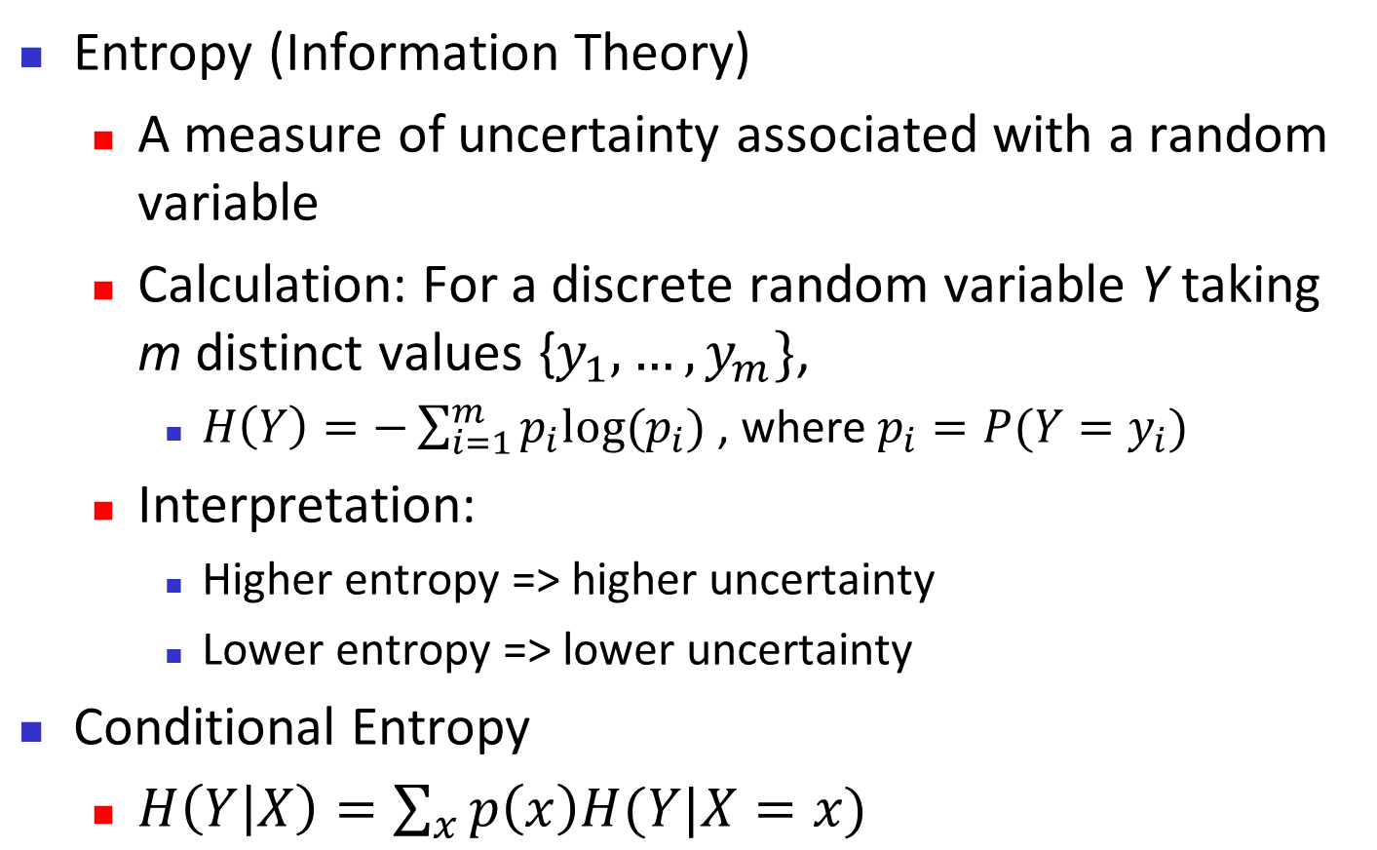
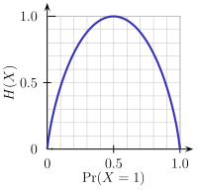
Brief Review of Entropy
m = 2

Slide 6
Attribute Selection Measure: Information Gain (ID3/C4.5)
Select the attribute with the highest information gain
Let p_{i} be the probability that an arbitrary tuple in D belongs to class C_{i}, estimated by |C_{i, D}|/|D|
Expected information (entropy) needed to classify a tuple in D:
Information needed (after using A to split D into v partitions) to classify D:
Information gained by branching on attribute A
Notes:
I : the expected information needed to classify a given sample
E (entropy) : expected information based on the partitioning into subsets by A

Slide 7
Attribute Selection: Information Gain
Class P: buys_computer = “yes”
Class N: buys_computer = “no”
means “age <=30” has 5 out of 14 samples, with 2 yes’es and 3 no’s. Hence
Similarly,

Slide 8
Computing Information-Gain for Continuous-Valued Attributes
Let attribute A be a continuous-valued attribute
Must determine the best split point for A
Sort the value A in increasing order
Typically, the midpoint between each pair of adjacent values is considered as a possible split point
(a_{i}+a_{i+1})/2 is the midpoint between the values of a_{i} and a_{i+1}
The point with the minimum expected information requirement for A is selected as the split-point for A
Split:
D1 is the set of tuples in D satisfying A ≤ split-point, and D2 is the set of tuples in D satisfying A > split-point

Slide 9
Gain Ratio for Attribute Selection (C4.5)
Information gain measure is biased towards attributes with a large number of values
C4.5 (a successor of ID3) uses gain ratio to overcome the problem (normalization to information gain)
GainRatio(A) = Gain(A)/SplitInfo(A)
Ex.
gain_ratio(income) = 0.029/1.557 = 0.019
The attribute with the maximum gain ratio is selected as the splitting attribute

Slide 10
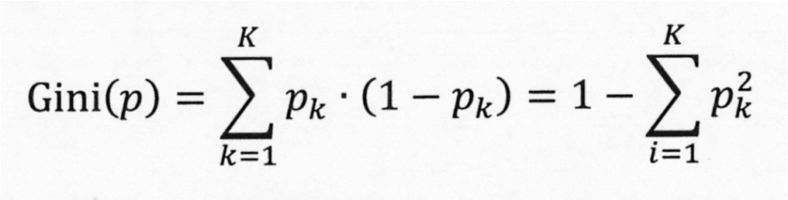

Slide 11
Gini Index (CART, IBM IntelligentMiner)
If a data set D contains examples from n classes, gini index, gini(D) is defined as
where p_{j} is the relative frequency of class j in D
If a data set D is split on A into two subsets D₁ and D₂, the gini index gini(D) is defined as
Reduction in Impurity:
The attribute provides the smallest gini_{split}(D) (or the largest reduction in impurity) is chosen to split the node (need to enumerate all the possible splitting points for each attribute)

Slide 12
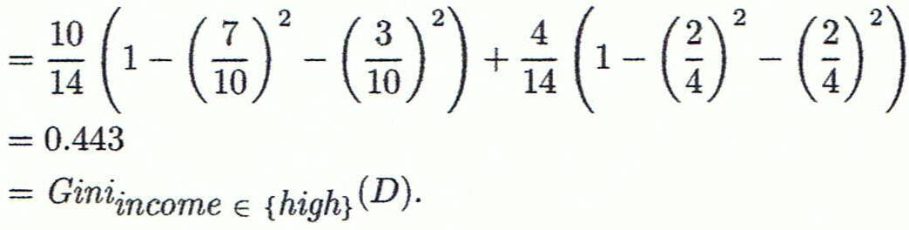
Computation of Gini Index
Ex. D has 9 tuples in buys_computer = “yes” and 5 in “no”
Suppose the attribute income partitions D into 10 in D₁: {low, medium} and 4 in D₂
Gini_{{low,high}} is 0.458; Gini_{{medium,high}} is 0.450. Thus, split on the {low,medium} (and {high}) since it has the lowest Gini index
All attributes are assumed continuous-valued
May need other tools, e.g., clustering, to get the possible split values
Can be modified for categorical attributes

Slide 13
Comparing Attribute Selection Measures
The three measures, in general, return good results but
Information gain:
biased towards multivalued attributes
Gain ratio:
tends to prefer unbalanced splits in which one partition is much smaller than the others
Gini index:
biased to multivalued attributes
has difficulty when # of classes is large
tends to favor tests that result in equal-sized partitions and purity in both partitions

Slide 14
Other Attribute Selection Measures
CHAID: a popular decision tree algorithm, measure based on χ² test for independence
C-SEP: performs better than info. gain and gini index in certain cases
G-statistic: has a close approximation to χ² distribution
MDL (Minimal Description Length) principle (i.e., the simplest solution is preferred):
The best tree as the one that requires the fewest # of bits to both (1) encode the tree, and (2) encode the exceptions to the tree
Multivariate splits (partition based on multiple variable combinations)
CART: finds multivariate splits based on a linear comb. of attrs.
Which attribute selection measure is the best?
Most give good results, none is significantly superior than others

Slide 15
ID3算法
Calculate the entropy of every attribute {\displaystyle a}a of the data set {\displaystyle S}S.
Partition ("split") the set {\displaystyle S}S into subsets using the attribute for which the resulting entropy after splitting is minimized; or, equivalently, information gain is maximum
Make a decision tree node containing that attribute.
Recurse on subsets using the remaining attributes.
越是小型的決策樹越優於大的決策樹（簡單理論）。
儘管如此，該算法也不是總是生成最小的樹形結構。
是一個啟發式算法

Slide 16
C4.5算法
檢查上述基本情況
對於每個特徵a，計算劃分a的信息增益
記a_best為最高信息增益的特徵
創建一個在a_best上劃分的決策節點
使用劃分後的樣本創建作為當前決策節點的子節點，並在這些子節點上遞歸地處理

Slide 17
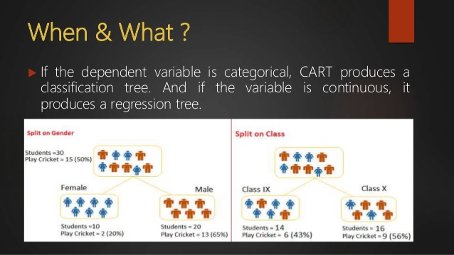
CART – Classification & Regression Trees
https://www.slideshare.net/hemantchetwani/cart-classification-regression-trees

Slide 18
CART (Classification And Regression Tree)
Breiman, Leo; Friedman, J. H., Olshen, R. A., & Stone, C. J. Classification and regression trees. Monterey, CA: Wadsworth & Brooks/Cole Advanced Books & Software. 1984. ISBN 978-0-412-04841-8.
Decision trees are formed by a collection of rules based on variables in the modeling data set:
Rules based on variables' values are selected to get the best split to differentiate observations based on the dependent variable
Once a rule is selected and splits a node into two, the same process is applied to each "child" node (i.e. it is a recursive procedure)
Splitting stops when CART detects no further gain can be made, or some pre-set stopping rules are met. (Alternatively, the data are split as much as possible and then the tree is later pruned.)
Each branch of the tree ends in a terminal node.
Each observation falls into one and exactly one terminal node, and each terminal node is uniquely defined by a set of rules.

Slide 19
Overfitting and Tree Pruning(樹支修剪)
Overfitting: An induced tree may overfit the training data
Too many branches, some may reflect anomalies due to noise or outliers
Poor accuracy for unseen samples
Two approaches to avoid overfitting 樹支修剪的兩種方法
Prepruning: Halt tree construction early ̵ do not split a node if this would result in the goodness measure falling below a threshold
Difficult to choose an appropriate threshold
Postpruning: Remove branches from a “fully grown” tree—get a sequence of progressively pruned trees
Use a set of data different from the training data to decide which is the “best pruned tree”

Slide 20
Enhancements to Basic Decision Tree Induction 基本決策樹的加強版
Allow for continuous-valued attributes
Dynamically define new discrete-valued attributes that partition the continuous attribute value into a discrete set of intervals
Handle missing attribute values
Assign the most common value of the attribute
Assign probability to each of the possible values
Attribute construction
Create new attributes based on existing ones that are sparsely represented
This reduces fragmentation, repetition, and replication

Slide 21
Sklearn
Decision Tree

Slide 22
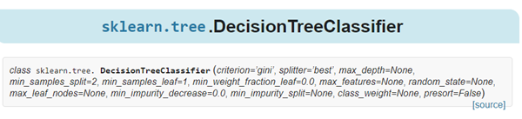
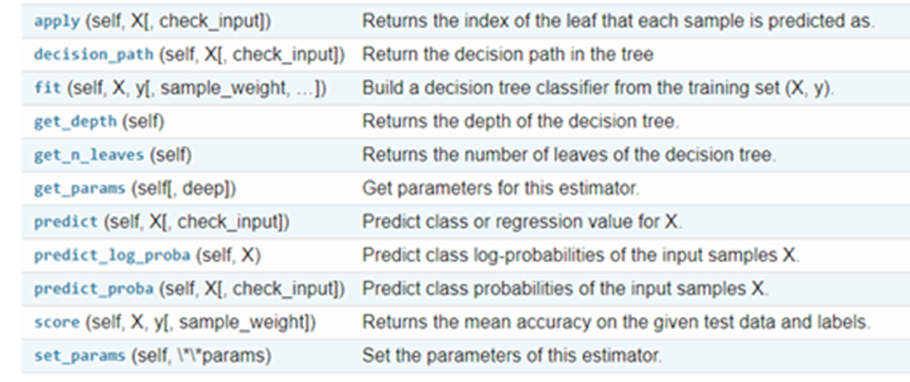
Parameters 參數
Attributes 屬性
https://scikit-learn.org/stable/modules/generated/sklearn.tree.DecisionTreeClassifier.html
Methods
方法
L. Breiman, J. Friedman, R. Olshen, and C. Stone, “Classification and Regression Trees”, Wadsworth, Belmont, CA, 1984.

Slide 23
class sklearn.tree.DecisionTreeClassifier(
criterion=’gini’,
splitter=’best’,
max_depth=None,
min_samples_split=2,
min_samples_leaf=1,
min_weight_fraction_leaf=0.0,
max_features=None,
random_state=None,
max_leaf_nodes=None,
min_impurity_decrease=0.0,
min_impurity_split=None,
class_weight=None,
presort=False)
criterion : string, optional (default=”gini”)
The function to measure the quality of a split. Supported criteria are “gini” for the Gini impurity and “entropy” for the information gain.
splitter : string, optional (default=”best”)
The strategy used to choose the split at each node. Supported strategies are “best” to choose the best split and “random” to choose the best random split.

Slide 24
Sklearn
Decision Tree
DEMO

Slide 25
from pandas import read_csv
from sklearn.model_selection import KFold
from sklearn.model_selection import cross_val_score
from sklearn.tree import DecisionTreeClassifier
# 導入數據
filename = 'pima_data.csv'
names = ['preg', 'plas', 'pres', 'skin', 'test', 'mass', 'pedi', 'age', 'class']
data = read_csv(filename, names=names)
# 將資料分為輸入資料和輸出結果
array = data.values
X = array[:, 0:8]
Y = array[:, 8]

Slide 26
num_folds = 10
seed = 7
kfold = KFold(n_splits=num_folds, random_state=seed)
model = DecisionTreeClassifier()
result = cross_val_score(model, X, Y, cv=kfold)
print(result.mean())
0.6886876281613123

Slide 27
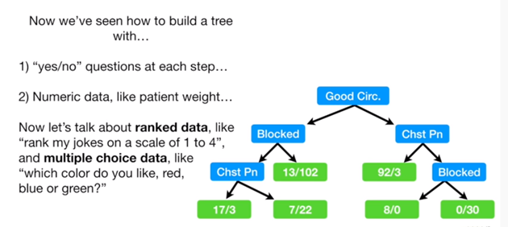
StatQuest: Decision Trees
https://www.youtube.com/watch?v=7VeUPuFGJHk

Slide 28
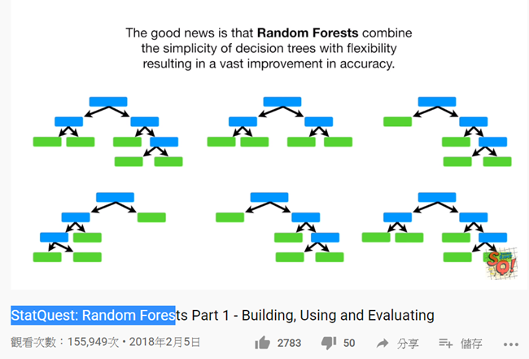
StatQuest: Random Forests Part 1 - Building, Using and Evaluating
https://www.youtube.com/watch?v=J4Wdy0Wc_xQ
StatQuest: Random Forests Part 2: Missing data and clustering
https://www.youtube.com/watch?v=nyxTdL_4Q-Q

Slide 29
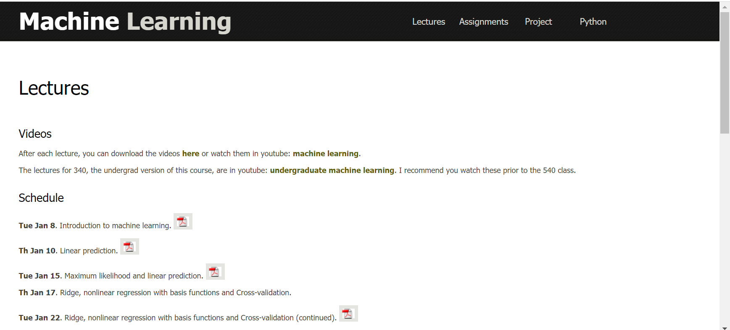
https://www.cs.ubc.ca/~nando/540-2013/lectures.html

Slide 30
Ensemble Methods 集成方法

Slide 31
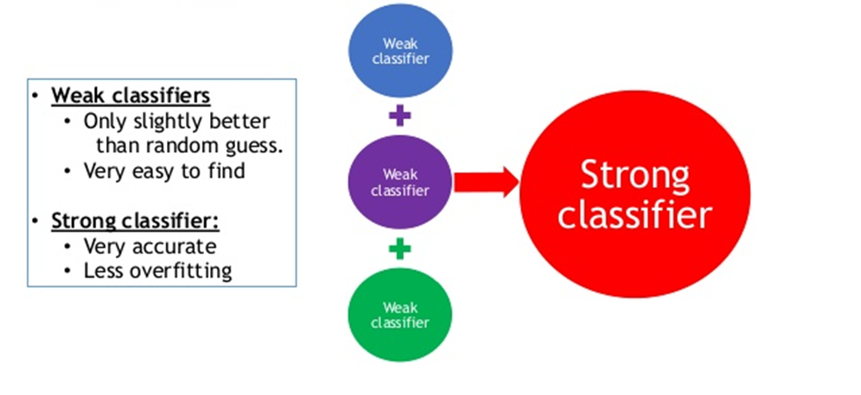
ensemble methods
combine different classifiers into a metaclassifier that has better generalization performance than each individual classifier alone.

Slide 32
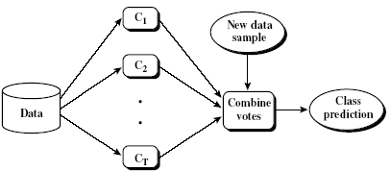
Ensemble Methods: Increasing the Accuracy
Ensemble methods
Use a combination of models to increase accuracy
Combine a series of k learned models, M₁, M₂, …, M_{k}, with the aim of creating an improved model M*
Popular ensemble methods
Bagging[裝袋模型]: averaging the prediction over a collection of classifiers
Boosting: weighted vote with a collection of classifiers
Stacking Ensemble: combining a set of heterogeneous classifiers[不同異質的分類器]
Boosting, Bagging and Stacking — A Comparative Analysis (2019 India Elections Case Study)
32

Slide 33
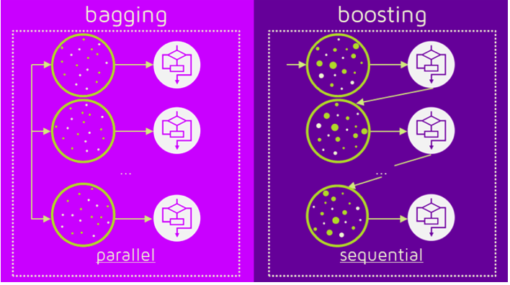
Bagging Vs Boosting
(Source : https://quantdare.com/what-is-the-difference-between-bagging-and-boosting/)

Slide 34
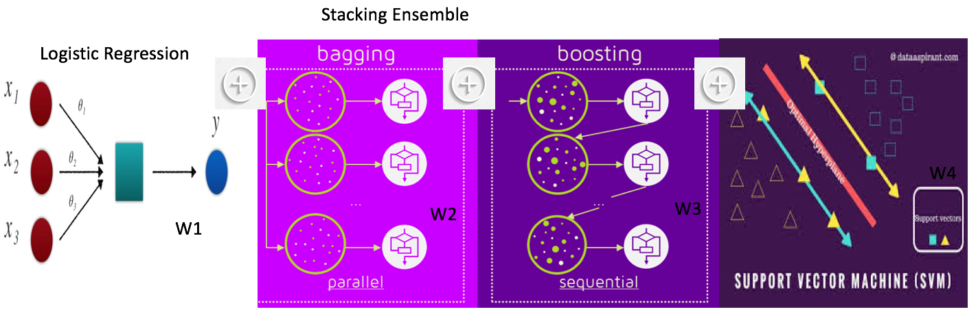
Stacking Ensemble with Logistic Regression + Bagging + Boosting + SVM
https://medium.com/analytics-vidhya/boosting-bagging-and-stacking-a-comparative-analysis-e6b213d416b9

Slide 35
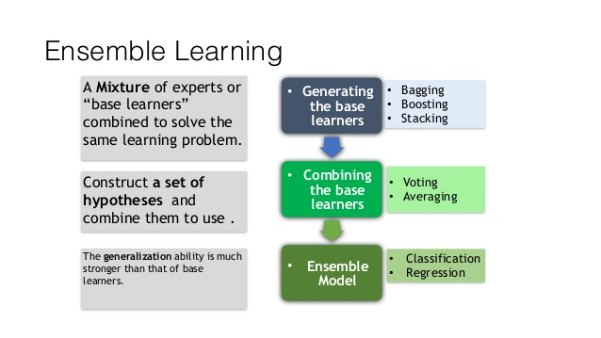

Slide 36

Ensemble Methods 整合方法|集成方法
Bagging
Boosting
Stacking
sklearn不直接支援stacking演算法
Adaboost
(Freund and Schapire, 1997)
Random Forest
(Breiman 2001)
GradientBoosting
Extra-Trees
Extremely randomized trees
極端隨機樹
PierreGeurts …. 2006
Gradient Boosted Decision Tree (GBDT)
Mlxtend
(machine learning extensions)
XGBoost (2014)
Extreme Gradient Boosting
陳天奇
LightGBM(2017)
Light Gradient Boosting Machine
CatBoost (2017)
categorical boosting
https://codertw.com/程式語言/462455/
https://zhuanlan.zhihu.com/p/26890738

Slide 37
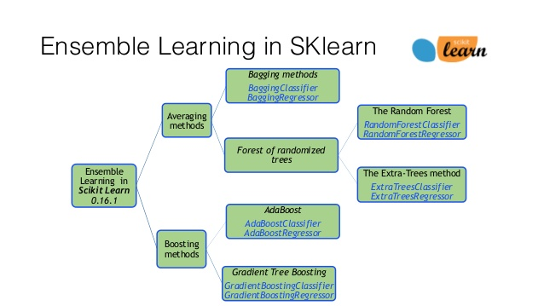
Boosting Algorithms Omar Odibat
https://www.slideshare.net/omarodibat/boosting-algorithms-omar-odibat

Slide 38
VotingClassifier

Slide 39
from sklearn.ensemble import RandomForestClassifier
from sklearn.ensemble import VotingClassifier
from sklearn.linear_model import LogisticRegression
from sklearn.svm import SVC
from sklearn.model_selection import train_test_split
from sklearn.datasets import make_moons
from sklearn.metrics import accuracy_score
# 匯入資料
X, y = make_moons(n_samples=500, noise=0.30, random_state=42)
X_train, X_test, y_train, y_test = train_test_split(X, y, random_state=42)

Slide 40
# 三個基學習器
log_clf = LogisticRegression()
rf_clf = RandomForestClassifier()
svm_clf = SVC()
# 投票分類器
voting_clf = VotingClassifier( estimators=[("lr", log_clf), ("rf", rf_clf), ("svc", svm_clf)], voting="hard" )
# voting_clf.fit( X_train, y_train )
for clf in ( log_clf, rf_clf, svm_clf, voting_clf ):
clf.fit( X_train, y_train )
y_pred = clf.predict( X_test )
print( clf.__class__.__name__, accuracy_score(y_test, y_pred) )

Slide 41
Bagging

Slide 42
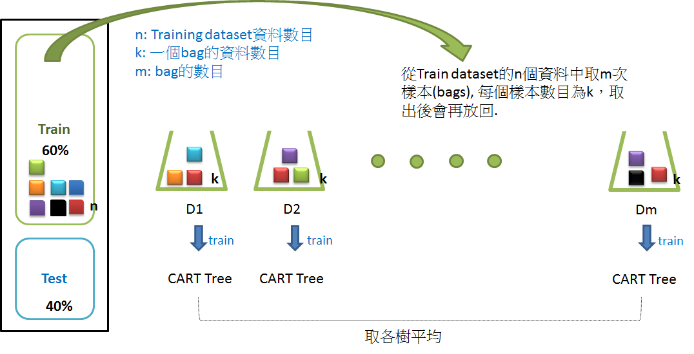
https://chtseng.wordpress.com/2017/02/24/%E9%9A%A8%E6%A9%9F%E6%A3%AE%E6%9E%97random-forest/

Slide 43
Bagging
Random Forest

Slide 44
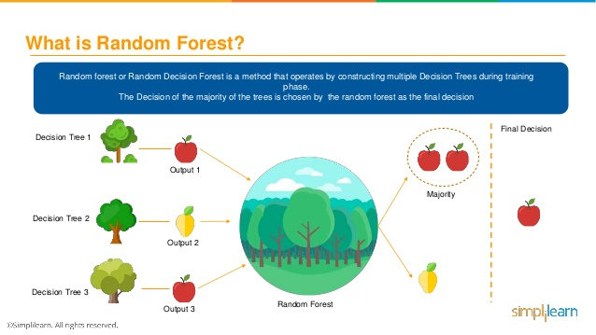
https://www.youtube.com/watch?v=eM4uJ6XGnSM
Random Forest Algorithm - Random Forest Explained | Random Forest In Machine Learning | Simplilearn
https://www.slideshare.net/Simplilearn/random-forest-algorithm-random-forest-explained-random-forest-in-machine-learning-simplilearn-91647398?qid=ed9145ef-fa4a-400b-8f90-f66816d5a31a&v=&b=&from_search=2

Slide 45
Bagging
Extra-Trees
Extremely randomized trees
極端隨機樹

Slide 46
Boosting Tree
提升樹

Slide 48
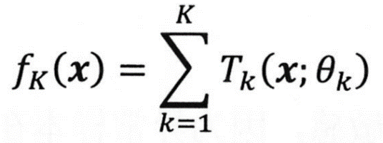
最後的集成決策函教
第k輪得到的base 分類器
加法模型

Slide 49
根據前向分布算法
第k輪得到的提升樹模型
使提升樹模型的整体損失函教
最小化去計算出
損失函教

Slide 50
損失函數Loss Function
不同問題使用不同損失函數
可微分!
分類問題
使用指數損失函數
使用對數損失函數
回歸問題
使用平方損失函數

Slide 51
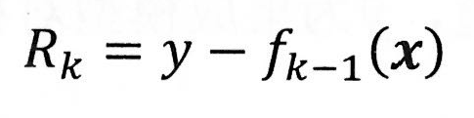

Slide 53
Boosting
Friedman, Jerome H. (1991). "Multivariate adaptive regression splines". Annals of Statistics. 19 (1): 1–67. CiteSeerX 10.1.1.382.970. doi:10.1214/aos/1176347963. JSTOR 2241837.
Friedman, Jerome H. (2001). "Greedy function approximation: a gradient boosting machine". Annals of Statistics. 29 (5): 1189–1232. doi:10.1214/aos/1013203451. JSTOR 2699986
GBDT
https://www.jianshu.com/p/005a4e6ac775

Slide 54
如果損失函數Loss Function
不可微分怎麼辦!
可微分==直接使用 梯度下降法 求解 ，來求得各base learner中的參數
分類問題
不同問題使用不同損失函數
使用指數損失函數
使用對數損失函數
回歸問題
使用平方損失函數

Slide 55
利用損失函數的負梯度將當前模型的值
來作為提升樹算法中殘差的近似替代
分類問題 === Gradient Boosting Decision Tree (GBDT)
回歸問題 === Gradient Boosting Regression Tree(GBRT)

Slide 56
泰勒展開Taylor Expansion (or Taylor Polynomial)
損失函數Loss Function

Slide 59
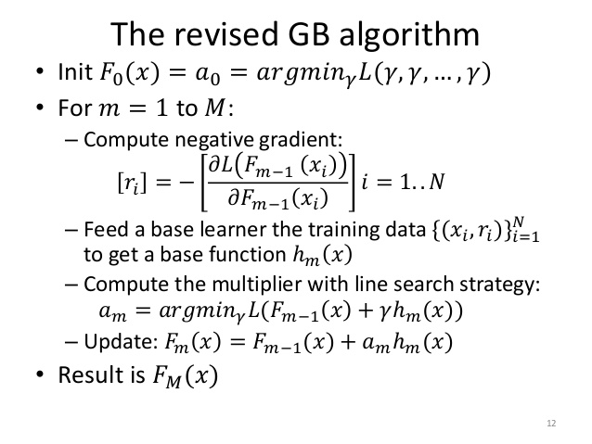

Slide 60
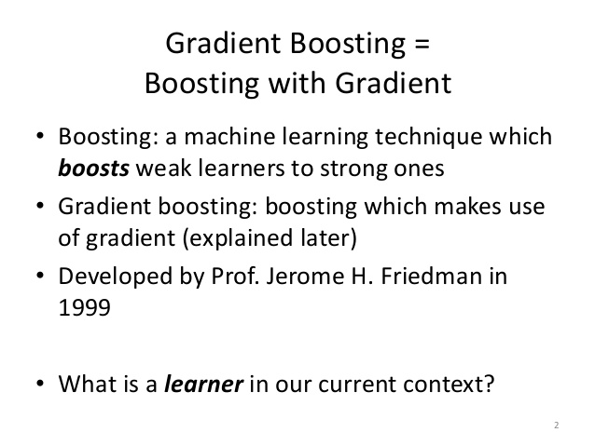
Gradient Boosting
https://www.slideshare.net/katatunix/gradient-boosting

Slide 61
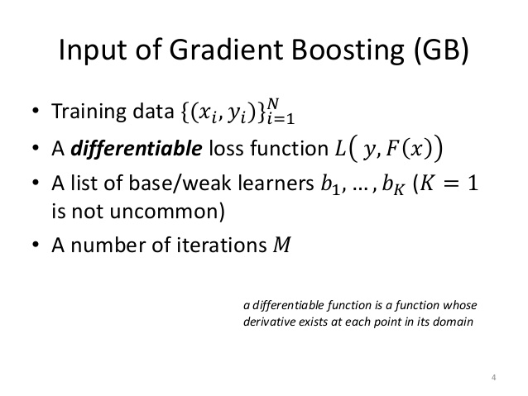

Slide 62
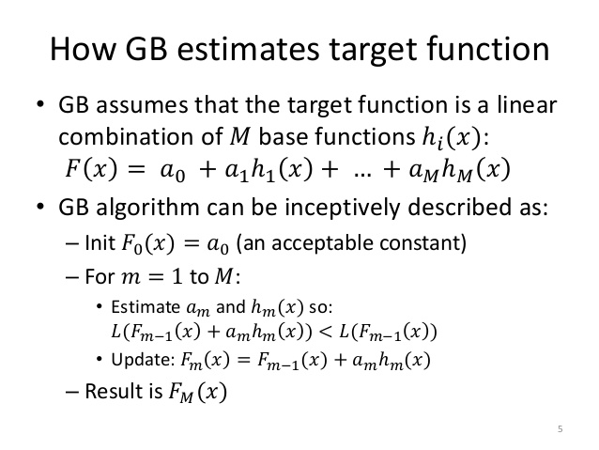

Slide 64
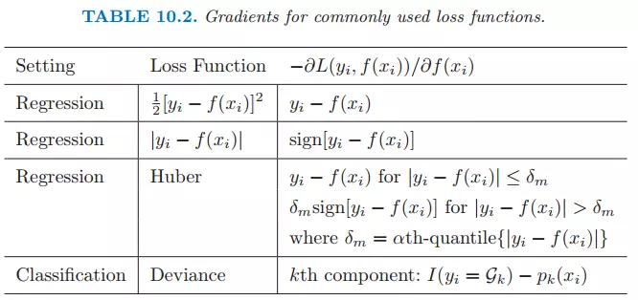

Slide 65
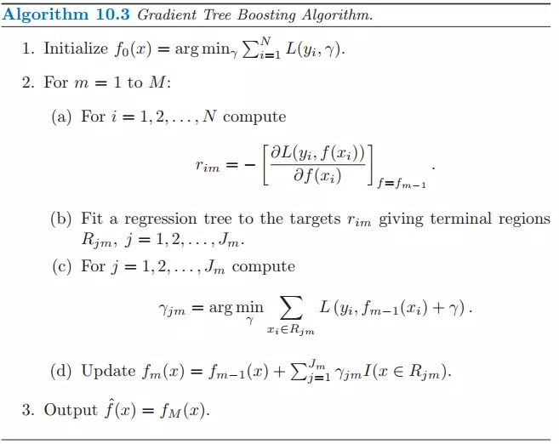

Slide 66
1、初始化，估計使損失函數極小化的常數值，它是只有一個根節點的樹，即ganma是一個常數值。
2、
（a）計算損失函數的負梯度在當前模型的值，將它作為殘差的估計
（b）估計回歸樹葉節點區域，以擬合殘差的近似值
（c）利用線性搜索估計葉節點區域的值，使損失函數極小化
（d）更新回歸樹
3、得到輸出的最終模型 f(x)

Slide 67
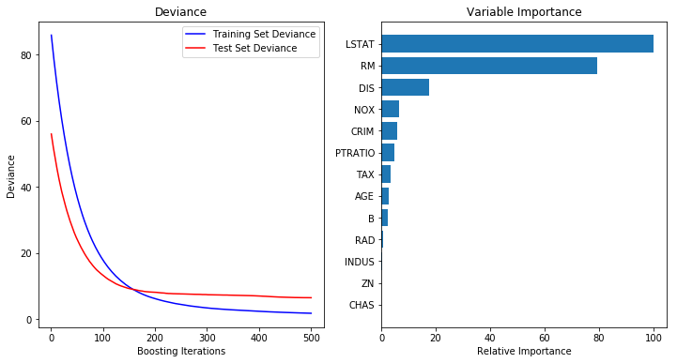
[範例]Gradient Boosting on the Boston housing dataset
https://scikit-learn.org/stable/auto_examples/ensemble/plot_gradient_boosting_regression.html

Slide 68

(2014)
Boosting
Tianqi Chen and Carlos Guestrin. Xgboost: A scalable tree boosting system. In Proceedings of the 22Nd ACM SIGKDD International
Conference on Knowledge Discovery and Data Mining, pages 785–794. ACM, 2016.
XGBoost (2014)
Extreme Gradient Boosting
https://github.com/dmlc/xgboost
https://homes.cs.washington.edu/~tqchen/pdf/BoostedTree.pdf

Slide 69

XGboost全名為eXtreme Gradient Boosting(極限梯度提升)，XGboost之所以被稱為Kaggle競賽神器主要是因為在Kaggle上很多比賽的第一名都使用了XGboost，在2015年的時候29個Kaggle冠軍隊伍中有17隊使用XGboost在他們的算法之中！由此可知XGboost的威力了！
XGBoost除了精準度很高之外，Training的速度也很異常的快，因此受到許多參賽者的喜愛。XGBoost之所以速度快主要是因為整個模型背後是用C++來實作，並且在算法上也做了很多的調整(高度利用CPU多核心平行運算)
XGBoost中的GBDT與傳統的GBDT在演算法層面有主要有兩處較大的不同:
XGBoost中的導數不是一階的,是二階的;
XGBoost中的剪枝部分在對葉子的個數做懲罰的同時還加入權重的懲罰.換言之,正則項進行了改進.
https://medium.com/jameslearningnote/%E8%B3%87%E6%96%99%E5%88%86%E6%9E%90-%E6%A9%9F%E5%99%A8%E5%AD%B8%E7%BF%92-%E7%AC%AC5-2%E8%AC%9B-kaggle%E6%A9%9F%E5%99%A8%E5%AD%B8%E7%BF%92%E7%AB%B6%E8%B3%BD%E7%A5%9E%E5%99%A8xgboost%E4%BB%8B%E7%B4%B9-1c8f55cffcc

Slide 71
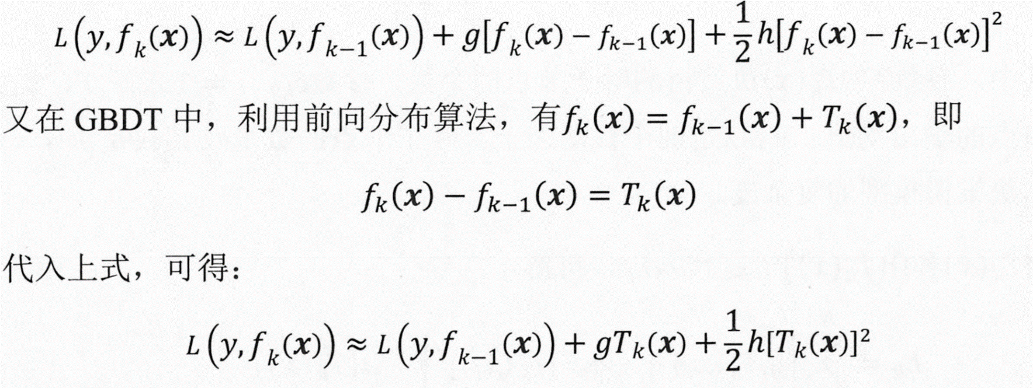

Slide 72
視為常數

Slide 76
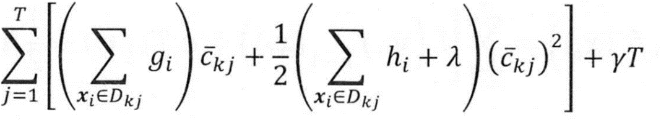
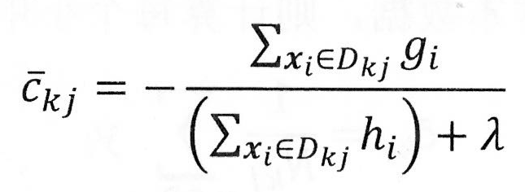

Slide 79
Take the challenges hosted by the machine learning competition site Kaggle for example.
Among the 29 challenge winning solutions published at Kaggle‘s blog during 2015, 17 solutions used XGBoost. Among these solutions, eight solely used XGBoost to train the model, while most others combined XGBoost with neural nets in ensembles.
For comparison, the second most popular method, deep neural nets, was used in 11 solutions.
The success of the system was also witnessed in KDDCup 2015, where XGBoost was used by every winning team in the top-10. Moreover, the winning teams reported that ensemble methods outperform a well-congured XGBoost by only a small amount

Slide 80
We design and build a highly scalable end-to-end tree boosting system.
We propose a theoretically justified weighted quantile sketch for effcient proposal calculation.
We introduce a novel sparsity-aware algorithm for parallel tree learning.
We propose an effective cache-aware block structure for out-of-core tree learning.

Slide 105
如何將多個弱分類器轉化為強分類器 ？
最直接的就是線性加權
: [公式] ,其中 [公式] 為第 [公式] 個分類器的權重, 當然我們也可以將其進一步變形為: [公式] ，其中 [公式]

Slide 106
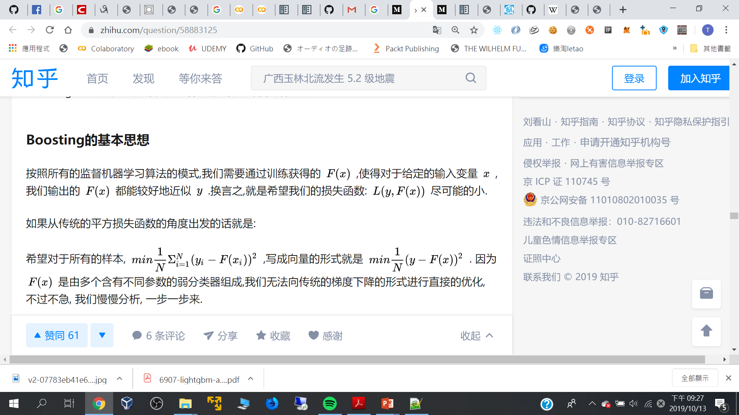
需要通過訓練獲得的 F(x),使得對於給定的輸入變數 x,我們輸出的 F(x) 都能較好地近似 y.
➔希望我們的損失函數盡可能的小
x
F(x)
y
損失函數的最小值
向量形式

Slide 107
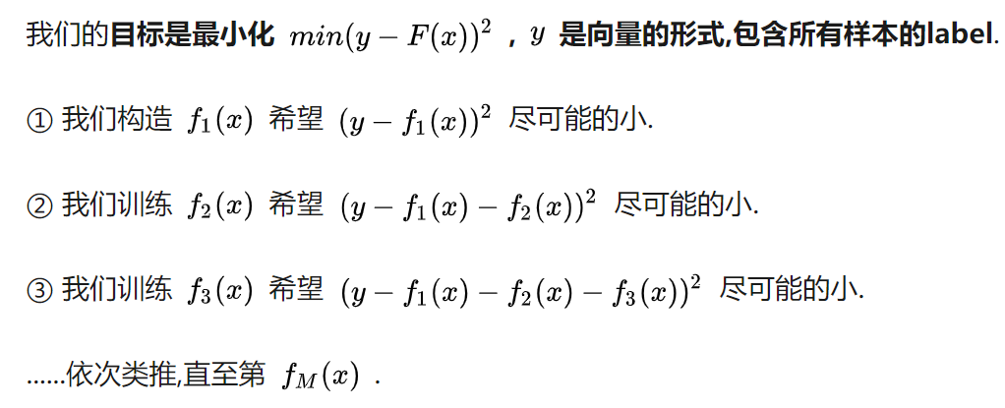
F(x)是由多個含有不同參數的弱分類器組成,
我們無法向傳統的梯度下降的形式進行直接的優化

Slide 108
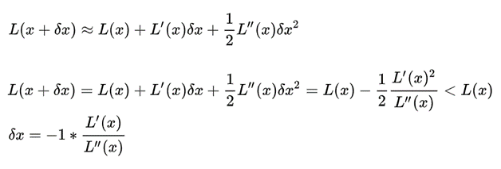

Slide 109
IevaZarina/xgboost_iris_prediction.py
https://gist.github.com/IevaZarina/ef63197e089169a9ea9f3109058a9679
https://www.kdnuggets.com/2017/03/simple-xgboost-tutorial-iris-dataset.html
import numpy as np
import xgboost as xgb
from sklearn import datasets
from sklearn.model_selection import train_test_split
from sklearn.datasets import dump_svmlight_file
from sklearn.externals import joblib
from sklearn.metrics import precision_score
iris = datasets.load_iris()
X = iris.data
y = iris.target
X_train, X_test, y_train, y_test = train_test_split(X, y, test_size=0.2, random_state=42)
Python 2

Slide 110
# use DMatrix for xgbosot
dtrain = xgb.DMatrix(X_train, label=y_train)
dtest = xgb.DMatrix(X_test, label=y_test)
# use svmlight file for xgboost
dump_svmlight_file(X_train, y_train, 'dtrain.svm', zero_based=True)
dump_svmlight_file(X_test, y_test, 'dtest.svm', zero_based=True)
dtrain_svm = xgb.DMatrix('dtrain.svm')
dtest_svm = xgb.DMatrix('dtest.svm')

Slide 111
# set xgboost params
param = {
'max_depth': 3, # the maximum depth of each tree
'eta': 0.3, # the training step for each iteration
'silent': 1, # logging mode - quiet
'objective': 'multi:softprob', # error evaluation for multiclass training
'num_class': 3} # the number of classes that exist in this datset
num_round = 20 # the number of training iterations

Slide 112
#------------- numpy array ------------------
# training and testing - numpy matrices
bst = xgb.train(param, dtrain, num_round)
preds = bst.predict(dtest)
# extracting most confident predictions
best_preds = np.asarray([np.argmax(line) for line in preds])
print "Numpy array precision:", precision_score(y_test, best_preds, average='macro')

Slide 113
# ------------- svm file ---------------------
# training and testing - svm file
bst_svm = xgb.train(param, dtrain_svm, num_round)
preds = bst.predict(dtest_svm)
# extracting most confident predictions
best_preds_svm = [np.argmax(line) for line in preds]
print "Svm file precision:",precision_score(y_test, best_preds_svm, average='macro')
# --------------------------------------------

Slide 114
# dump the models
bst.dump_model('dump.raw.txt')
bst_svm.dump_model('dump_svm.raw.txt')
# save the models for later
joblib.dump(bst, 'bst_model.pkl', compress=True)
joblib.dump(bst_svm, 'bst_svm_model.pkl', compress=True)

Slide 115
[14:06:57] 120x4 matrix with 480 entries loaded from dtrain.svm
[14:06:57] 30x4 matrix with 120 entries loaded from dtest.svm
Numpy array precision: 1.0
Svm file precision: 1.0
['bst_svm_model.pkl']

Slide 116
Boosting
LightGBM(2017)

Slide 117
https://github.com/Microsoft/LightGBM
Gradient Boosting Decision Tree (GBDT) is a popular machine learning algorithm,
and has quite a few effective implementations such as XGBoost and pGBRT.
Although many engineering optimizations have been adopted in these implementations,
the efficiency and scalability are still unsatisfactory when the feature dimension is high and data size is large. A major reason is that for each feature, they need to scan all the data instances to estimate the information gain of all possible split points, which is very time consuming.
To tackle this problem, we propose two novel techniques:
Gradient-based One-Side Sampling (GOSS) and Exclusive Feature Bundling (EFB).

Slide 118
LightGBM(2017) Light Gradient Boosting Machine
https://github.com/Microsoft/LightGBM
Parallel Learning and GPU Learning
https://lightgbm.readthedocs.io/en/latest/
https://lightgbm.apachecn.org/#/
是一個實現GBDT演算法的框架，支援高效率的並行訓練，並且具有以下優點：
● 更快的訓練速度
● 更低的記憶體消耗
● 更好的準確率
● 分散式支援，可以快速處理海量資料
Guolin Ke, Qi Meng, Thomas Finley, Taifeng Wang, Wei Chen, Weidong Ma, Qiwei Ye, Tie-Yan Liu. "LightGBM: A Highly Efficient Gradient Boosting Decision Tree". Advances in Neural Information Processing Systems 30 (NIPS 2017), pp. 3149-3157.
Qi Meng, Guolin Ke, Taifeng Wang, Wei Chen, Qiwei Ye, Zhi-Ming Ma, Tie-Yan Liu. "A Communication-Efficient Parallel Algorithm for Decision Tree". Advances in Neural Information Processing Systems 29 (NIPS 2016), pp. 1279-1287.
Huan Zhang, Si Si and Cho-Jui Hsieh. "GPU Acceleration for Large-scale Tree Boosting". SysML Conference, 2018.
https://www.msra.cn/zh-cn/news/features/lightgbm-20170105

Slide 119
LightGBM 是一個梯度 boosting 框架, 使用基於學習演算法的決策樹. 它是分散式的, 高效的
LightGBM優勢:
速度和記憶體使用的優化
減少分割增益的計算量
通過長條圖的相減來進行進一步的加速
減少記憶體的使用 減少並行學習的通信代價
稀疏優化
准確率的優化
Leaf-wise (Best-first) 的決策樹生長策略
類別特徵值的最優分割
網絡通信的優化
並行學習的優化
特徵並行
數據並行
投票並行
GPU 支援可處理大規模資料
LightGBM 中文文檔
https://lightgbm.apachecn.org/#/

Slide 120
LigthGBM和xgboost一樣是對GBDT的高效實現，很多方面會比xgboost表現的更為優秀。
原理上它和GBDT及xgboot類似，都採用損失函數的負梯度作為當前決策樹的殘差近似值，去擬合新的決策樹。
LightGBM的特點:
1、採用直方圖算法
2、樹的生長策略優化
3、相對於xgboost和GBDT,LightGBM提出了兩個新方法，使得LightGBM的效率要顯著要高於GBDT和xgboost。
這兩種新方法是：
Gradient-based One-Side Sampling (GOSS：基於梯度的one-side採樣) 和
Exclusive Feature Bundling (EFB：互斥的特徵捆綁）
https://kknews.cc/code/grbzab8.html

Slide 123
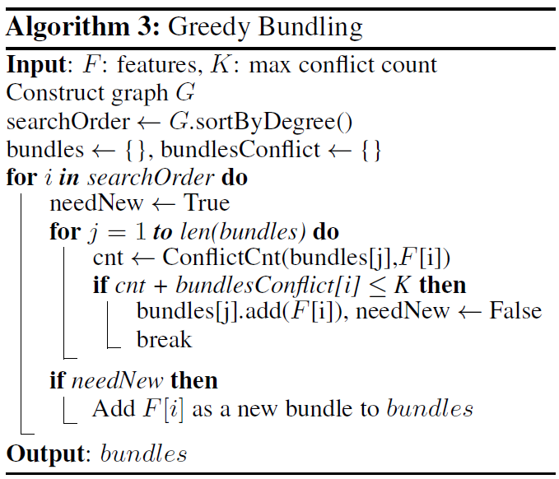
Gradient-based One-Side Sampling

Slide 125
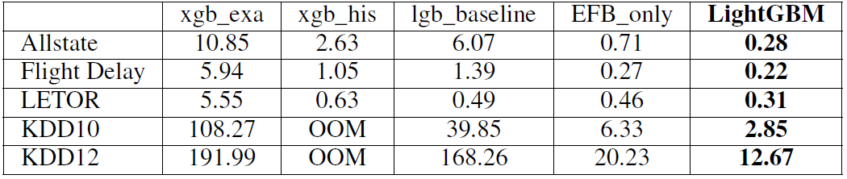
使用五種資料集測試
Overall training time cost comparison
Overall accuracy comparison on test datasets

Slide 127
import lightgbm as lgb
lgb.__version__
Google Colab內建
'2.2.3'
https://medium.com/@am.sharma/lgbm-on-colab-with-gpu-c1c09e83f2af
Installing GPU support for LightGBM on Google Collab
https://stackoverflow.com/questions/49606886/installing-gpu-support-for-lightgbm-on-google-collab
!pip install lightgbm --install-option=--gpu
pip install lightgbm --install-option=--gpu --install-option="--opencl-include-dir=/usr/local/cuda/include/" --install-option="--opencl-library=/usr/local/cuda/lib64/libOpenCL.so"

Slide 128
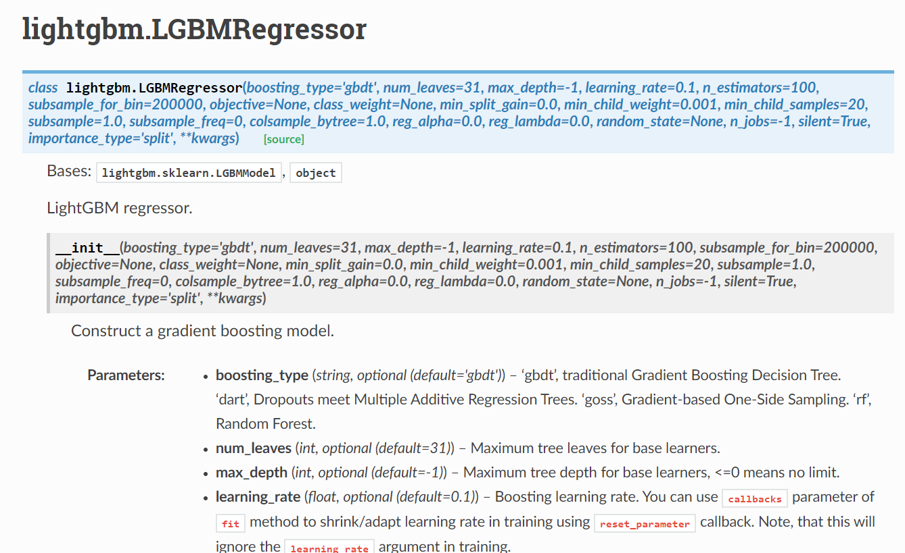
https://lightgbm.readthedocs.io/en/latest/pythonapi/lightgbm.LGBMRegressor.html#lightgbm.LGBMRegressor
https://lightgbm.readthedocs.io/en/latest/Python-API.html

Slide 129
import lightgbm as lgb
from sklearn.datasets import load_iris
from sklearn.model_selection import train_test_split
import pandas as pd
iris = load_iris()
data=iris.data
target = iris.target
X_train,X_test,y_train,y_test =train_test_split(data,target,test_size=0.25)
gbm = lgb.LGBMRegressor(learning_rate=0.03,n_estimators=200，max_depth=8)
gbm.fit(X_train, y_train)
#預測結果
y_pred = gbm.predict(X_test, num_iteration=gbm.best_iteration_)
https://kknews.cc/code/grbzab8.html

Slide 130
原生形式使用lightgbm(import lightgbm as lgb)
import lightgbm as lgb
from sklearn.metrics import mean_squared_error
from sklearn.datasets import load_iris
from sklearn.model_selection import train_test_split
# 載入數據
iris = load_iris()
data = iris.data
target = iris.target
# 劃分訓練集和測試集
X_train, X_test, y_train, y_test = train_test_split(data, target, test_size=0.2)
print("Train data length:", len(X_train))
print("Test data length:", len(X_test))
# 轉換為Dataset資料格式
lgb_train = lgb.Dataset(X_train, y_train)
lgb_eval = lgb.Dataset(X_test, y_test, reference=lgb_train)
https://www.cnblogs.com/chenxiangzhen/p/10894306.html

Slide 131
# 參數
params = {
'task': 'train',
'boosting_type': 'gbdt', # 設置提升類型
'objective': 'regression', # 目標函數
'metric': {'l2', 'auc'}, # 評估函數
'num_leaves': 31, # 葉子節點數
'learning_rate': 0.05, # 學習速率
'feature_fraction': 0.9, # 建樹的特徵選擇比例
'bagging_fraction': 0.8, # 建樹的樣本採樣比例
'bagging_freq': 5, # k 意味著每 k 次反覆運算執行bagging
'verbose': 1 # <0 顯示致命的, =0 顯示錯誤 (警告), >0 顯示資訊
}

Slide 132
# 模型訓練
gbm = lgb.train(params, lgb_train, num_boost_round=20, valid_sets=lgb_eval, early_stopping_rounds=5)
# 模型保存
gbm.save_model('model.txt')
# 模型載入
gbm = lgb.Booster(model_file='model.txt')
# 模型預測
y_pred = gbm.predict(X_test, num_iteration=gbm.best_iteration)
# 模型評估
print('The rmse of prediction is:', mean_squared_error(y_test, y_pred) ** 0.5)

Slide 133
Train data length: 120
Test data length: 30
[1] valid_0's auc: 1 valid_0's l2: 0.707913
Training until validation scores don't improve for 5 rounds.
[2] valid_0's auc: 1 valid_0's l2: 0.640658
[3] valid_0's auc: 1 valid_0's l2: 0.582781
[4] valid_0's auc: 1 valid_0's l2: 0.527667
[5] valid_0's auc: 1 valid_0's l2: 0.480366
[6] valid_0's auc: 1 valid_0's l2: 0.43568
Early stopping, best iteration is:
[1] valid_0's auc: 1 valid_0's l2: 0.707913
The rmse of prediction is: 0.8413759267008777

Slide 134
Sklearn接口形式使用lightgbm(from lightgbm import LGBMRegressor)
from lightgbm import LGBMRegressor
from sklearn.metrics import mean_squared_error
from sklearn.model_selection import GridSearchCV
from sklearn.datasets import load_iris
from sklearn.model_selection import train_test_split
from sklearn.externals import joblib
# 載入數據
iris = load_iris()
data = iris.data
target = iris.target
# 劃分訓練資料和測試資料
X_train, X_test, y_train, y_test = train_test_split(data, target, test_size=0.2)

Slide 135
# 模型訓練
gbm = LGBMRegressor(objective='regression', num_leaves=31, learning_rate=0.05, n_estimators=20)
gbm.fit(X_train, y_train, eval_set=[(X_test, y_test)], eval_metric='l1', early_stopping_rounds=5)
# 模型存儲
joblib.dump(gbm, 'loan_model.pkl')
# 模型載入
gbm = joblib.load('loan_model.pkl')
# 模型預測
y_pred = gbm.predict(X_test, num_iteration=gbm.best_iteration_)
# 模型評估
print('The rmse of prediction is:', mean_squared_error(y_test, y_pred) ** 0.5)
# 特徵重要度
print('Feature importances:', list(gbm.feature_importances_))

Slide 136
# 網格搜索，參數優化
estimator = LGBMRegressor(num_leaves=31)
param_grid = {
'learning_rate': [0.01, 0.1, 1],
'n_estimators': [20, 40]
}
gbm = GridSearchCV(estimator, param_grid)
gbm.fit(X_train, y_train)
print('Best parameters found by grid search are:', gbm.best_params_)

Slide 137
[1] valid_0's l2: 0.604116 valid_0's l1: 0.636243
Training until validation scores don't improve for 5 rounds.
[2] valid_0's l2: 0.547563 valid_0's l1: 0.607341
[3] valid_0's l2: 0.496428 valid_0's l1: 0.579883
[4] valid_0's l2: 0.448907 valid_0's l1: 0.552508
[5] valid_0's l2: 0.406207 valid_0's l1: 0.525982
[6] valid_0's l2: 0.368275 valid_0's l1: 0.502199
[7] valid_0's l2: 0.33307 valid_0's l1: 0.478542
[8] valid_0's l2: 0.301991 valid_0's l1: 0.456943
[9] valid_0's l2: 0.273125 valid_0's l1: 0.435438
[10] valid_0's l2: 0.247659 valid_0's l1: 0.415823
[11] valid_0's l2: 0.224672 valid_0's l1: 0.395259
[12] valid_0's l2: 0.203718 valid_0's l1: 0.377447
[13] valid_0's l2: 0.184308 valid_0's l1: 0.359298
[14] valid_0's l2: 0.167531 valid_0's l1: 0.344756
[15] valid_0's l2: 0.151905 valid_0's l1: 0.32908
[16] valid_0's l2: 0.137446 valid_0's l1: 0.313421
[17] valid_0's l2: 0.125012 valid_0's l1: 0.301277
[18] valid_0's l2: 0.11336 valid_0's l1: 0.287699
[19] valid_0's l2: 0.102544 valid_0's l1: 0.274284
[20] valid_0's l2: 0.0934265 valid_0's l1: 0.263758
Did not meet early stopping. Best iteration is:
[20] valid_0's l2: 0.0934265 valid_0's l1: 0.263758
The rmse of prediction is: 0.3056575573917436
Feature importances: [4, 0, 34, 14]

Slide 138
用sklearn進行機器學習的時候，我們需要對類別特徵進行預處理，如label encoding, one hot encoding等，
因為sklearn無法處理類別特徵，會報錯。
CatBoost (2017)
categorical boosting
https://www.zhangqibot.com/post/ml-catboost/

Slide 139
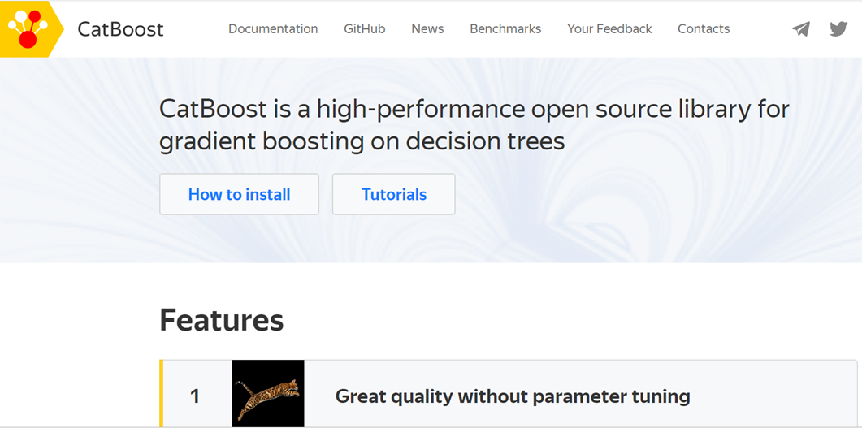
CatBoost (2017)
categorical boosting
Gradient Boosting(梯度提升) +
Categorical Features(類別型特徵)
官方地址：https://tech.yandex.com/CatBoost/
項目位址：https://github.com/catboost/catboost
論文地址：https://arxiv.org/abs/1706.09516
文檔地址：https://tech.yandex.com/catboost/doc/dg/concepts/about-docpage/
https://catboost.ai/
https://www.biaodianfu.com/catboost.html
https://blog.csdn.net/appleyuchi/article/details/85413352

Slide 140
許多利用GBDT技術的演算法（例如，XGBoost、LightGBM），
構建一棵樹分為兩個階段：
[Step 1]選擇樹結構
[Step 2]在樹結構固定後計算葉子節點的值。
為了選擇最佳的樹結構，演算法通過枚舉不同的分割，用這些分割構建樹，對得到的葉子節點中計算值，然後對得到的樹計算評分，最後選擇最佳的分割。
兩個階段葉子節點的值都是被當做梯度或牛頓步長的近似值來計算。
CatBoost第一階段採用梯度步長的無偏估計，
第二階段使用傳統的GBDT方案執行。

Slide 141
CatBoostClassifier
https://catboost.ai/docs/concepts/python-reference_catboostclassifier.html
class CatBoostClassifier(iterations=None,
learning_rate=None,
depth=None,
l2_leaf_reg=None,
model_size_reg=None,
rsm=None,
loss_function=None,
border_count=None,
feature_border_type=None,
per_float_feature_quantization=None,
input_borders=None,
output_borders=None,
fold_permutation_block=None,
od_pval=None,
od_wait=None,
…………………………………………..)

Slide 142
!pip install catboost
import numpy as np
import catboost as cb
train_data = np.random.randint(0, 100, size=(100, 10))
train_label = np.random.randint(0, 2, size=(100))
test_data = np.random.randint(0,100, size=(50,10))
model = cb.CatBoostClassifier(iterations=2, depth=2, learning_rate=0.5,
loss_function='Logloss',logging_level='Verbose')
model.fit(train_data, train_label, cat_features=[0,2,5])
preds_class = model.predict(test_data)
preds_probs = model.predict_proba(test_data)
print('class = ',preds_class)
print('proba = ',preds_probs)

Slide 143
0: learn: 0.6705108 total: 54.7ms remaining: 54.7ms
1: learn: 0.6578008 total: 55.3ms remaining: 0us
class = [1. 1. 1. 0. 0. 0. 0. 1. 1. 0. 1. 1. 1. 1. 0. 1. 1. 1. 1. 1. 0. 1. 1. 1.
1. 1. 0. 1. 1. 0. 1. 0. 1. 1. 1. 0. 0. 0. 1. 1. 1. 0. 1. 1. 1. 1. 0. 1.
1. 1.]
proba = [[0.41640267 0.58359733]
[0.478398 0.521602 ]
[0.478398 0.521602 ]
[0.5815617 0.4184383 ]

Slide 144
Pool
Pool是catboost中的用於組織資料的一種形式，也可以用numpy array和dataframe。但更推薦Pool，其記憶體和速度都更優。
https://catboost.ai/docs/concepts/python-reference_pool.html
class Pool(
data,
label=None,
cat_features=None,
column_description=None,
pairs=None,
delimiter='\t',
has_header=False,
weight=None,
group_id=None,
group_weight=None,
subgroup_id=None,
pairs_weight=None
baseline=None,
feature_names=None,
thread_count=-1)
Dataset processing.
The fastest way to pass the features data to the Pool constructor (and other CatBoost, CatBoostClassifier, CatBoostRegressor methods that accept it) if most (or all) of your features are numerical is to pass it using FeaturesData class.
Another way to get similar performance with datasets that contain numerical features only is to pass features data as numpy.ndarray with numpy.float32 dtype.
https://www.zhangqibot.com/post/ml-catboost/

Slide 145
#!/usr/bin/env python
# -*- coding: utf-8 -*-
from catboost import CatBoost
from catboost import Pool
from sklearn import datasets
from sklearn.model_selection import train_test_split
from sklearn.metrics import accuracy_score
https://blog.amedama.jp/entry/catboost

Slide 146
def main():
dataset = datasets.load_breast_cancer()
X, y = dataset.data, dataset.target
X_train, X_test, y_train, y_test = train_test_split(X, y, test_size=0.3, shuffle=True,
random_state=42,stratify=y)
train_pool = Pool(X_train, label=y_train)
test_pool = Pool(X_test, label=y_test)
params = {
'loss_function': 'Logloss',
'num_boost_round': 100,
}
model = CatBoost(params)
model.fit(train_pool)
y_pred = model.predict(test_pool, prediction_type='Class')
acc = accuracy_score(y_test, y_pred)
print('Accuracy:', acc)
if __name__ == '__main__':
main()

Slide 147
https://blog.amedama.jp/entry/catboost
#!/usr/bin/env python
# -*- coding: utf-8 -*-
from catboost import CatBoost
from catboost import Pool
from sklearn import datasets
from sklearn.model_selection import train_test_split
from sklearn.metrics import accuracy_score

Slide 148
def main():
dataset = datasets.load_iris()
X, y = dataset.data, dataset.target
X_train, X_test, y_train, y_test = train_test_split(X, y, test_size=0.3,shuffle=True,
random_state=42,stratify=y)
train_pool = Pool(X_train, label=y_train)
test_pool = Pool(X_test, label=y_test)
params = {
'loss_function': 'MultiClass', # 多値分類問題
'num_boost_round': 1000,
'early_stopping_rounds': 10,
}
model = CatBoost(params)
model.fit(train_pool, eval_set=[test_pool])
y_pred = model.predict(test_pool, prediction_type='Class')
acc = accuracy_score(y_test, y_pred)
print('Accuracy:', acc)
if __name__ == '__main__':
main()

Slide 149
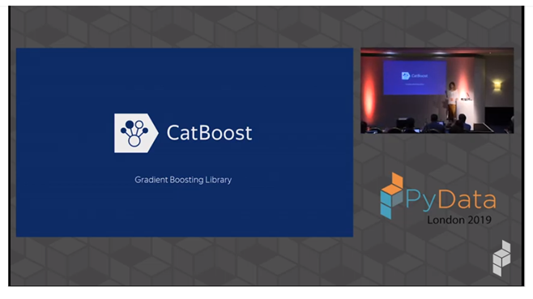
https://www.youtube.com/watch?time_continue=127&v=usdEWSDisS0
Anna Veronika Dorogush: Mastering gradient boosting with CatBoost | PyData London 2019
觀看次數：2,052次•2019年7月18日

Slide 150

Mlxtend

Slide 151
!pip install mlxtend
(machine learning extensions)
https://github.com/rasbt/mlxtend
classifier
Adaline
EnsembleVoteClassifier
LogisticRegression
NeuralNetMLP
Perceptron
regressor
LinearRegression
https://www.kaggle.com/arthurtok/introduction-to-ensembling-stacking-in-python?source=post_page-----523884f3bb98----------------------
https://gitee.com/mimio/mlxtend
https://www.kaggle.com/peterheindl/simple-model-stacking-using-mlxtend
https://computational-communication.com/mlxtend-intro/
https://colab.research.google.com/drive/1dkZITXbEM9hZykd5qyWZ2rljri1Pdtud

Slide 152
import numpy as np
import matplotlib.pyplot as plt
import matplotlib.gridspec as gridspec
import itertools
from sklearn.linear_model import LogisticRegression
from sklearn.svm import SVC
from sklearn.ensemble import RandomForestClassifier
from mlxtend.classifier import EnsembleVoteClassifier
from mlxtend.data import iris_data
from mlxtend.plotting import plot_decision_regions
# Initializing Classifiers
clf1 = LogisticRegression(random_state=0)
clf2 = RandomForestClassifier(random_state=0)
clf3 = SVC(random_state=0, probability=True)
eclf = EnsembleVoteClassifier(clfs=[clf1, clf2, clf3], weights=[2, 1, 1], voting='soft')
https://gitee.com/mimio/mlxtend

Slide 153
# Loading some example data
X, y = iris_data()
X = X[:,[0, 2]]
# Plotting Decision Regions
gs = gridspec.GridSpec(2, 2)
fig = plt.figure(figsize=(10, 8))
for clf, lab, grd in zip([clf1, clf2, clf3, eclf],
['Logistic Regression', 'Random Forest', 'RBF kernel SVM', 'Ensemble'],
itertools.product([0, 1], repeat=2)):
clf.fit(X, y)
ax = plt.subplot(gs[grd[0], grd[1]])
fig = plot_decision_regions(X=X, y=y, clf=clf, legend=2)
plt.title(lab)
plt.show()

Slide 154
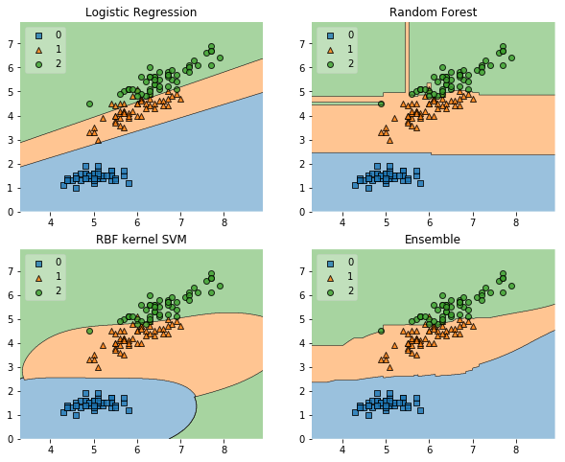

Slide 155
Boosting
Adaboost

Slide 156
from sklearn.datasets import load_iris
from sklearn.model_selection import train_test_split
from sklearn import ensemble
from sklearn.metrics import classification_report

Slide 157
# 載入sklearn自帶的iris（鳶尾花）資料集
iris = load_iris()
# 提取特徵資料和目標資料
X = iris.data
y = iris.target
# 將資料集以9:1的比例隨機分為訓練集和測試集
# 為了重現隨機分配設置隨機種子，即random_state參數
X_train, X_test, y_train, y_test = train_test_split(X, y, train_size=0.8, test_size=0.2, random_state=188)

Slide 158
# 產生實體分類器對象
clf = ensemble.AdaBoostClassifier()
# 分類器擬合訓練資料
clf.fit(X_train, y_train)
# 訓練完的分類器對測試資料進行預測
y_pred = clf.predict(X_test)
# classification_report函數用於顯示主要分類指標的文本報告
print(classification_report(y_test, y_pred, target_names=['setosa', 'versicolor', 'virginica']))

